Slide 1
Introduction to Computing for Data Analysis
Pairwise association mining
Richard Vuduc, Ph.D.
Associate Professor
School of Computational Science and Engineering
Association rule mining

Slide 2
For each topic in this class, we will:

Slide 3
For each topic in this class, we will:
Ask an analysis question
Formulate the problem
Devise an algorithm
Translate to code

Slide 4
For each topic in this class, we will:
Ask an analysis question
Formulate the problem
Devise an algorithm
Translate to code

Slide 5
For each topic in this class, we will:
Ask an analysis question
Formulate the problem
Devise an algorithm
Translate to code

Slide 6
For each topic in this class, we will:
Ask an analysis question
Formulate the problem
Devise an algorithm
Translate to code

Slide 7
For each topic in this class, we will:
Ask an analysis question
Formulate the problem
Devise an algorithm
Translate to code
???
Profit!

Slide 8
Association rule mining

Slide 9
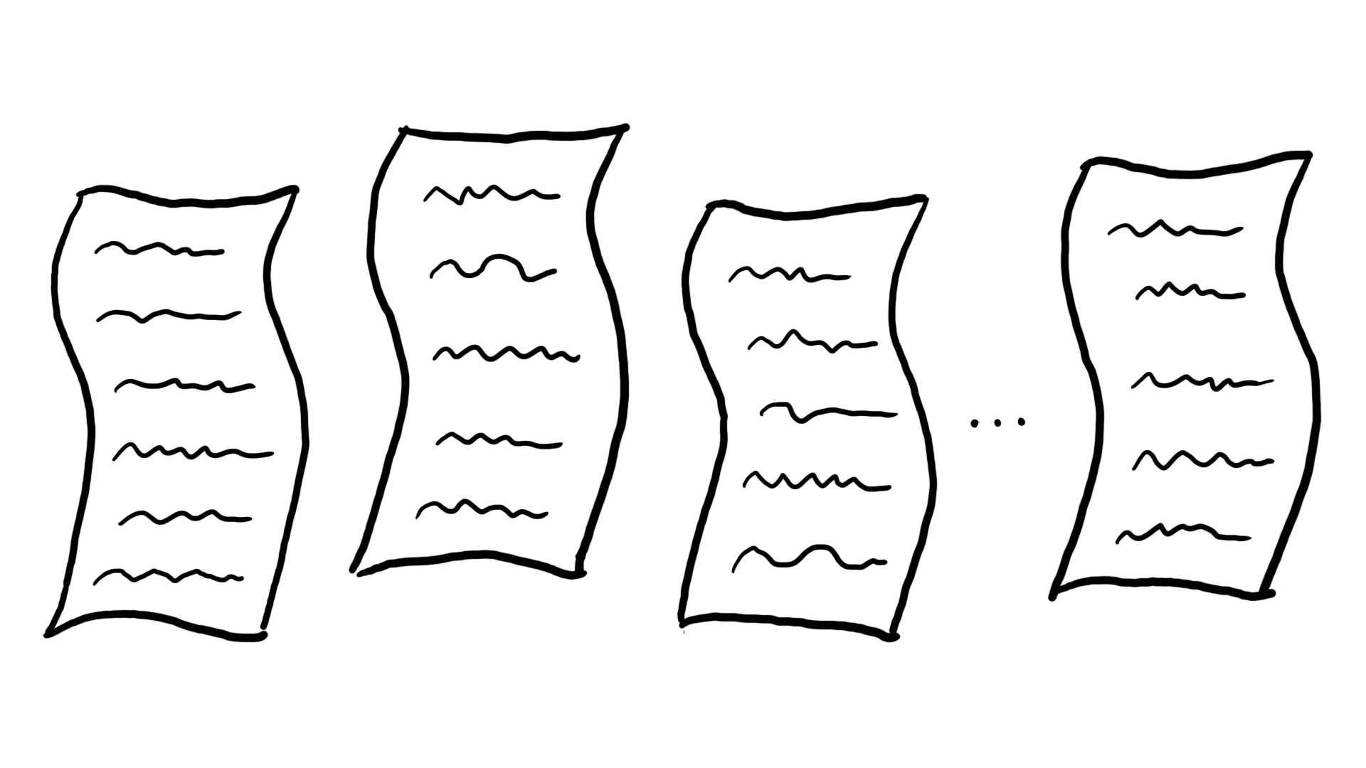

Slide 10
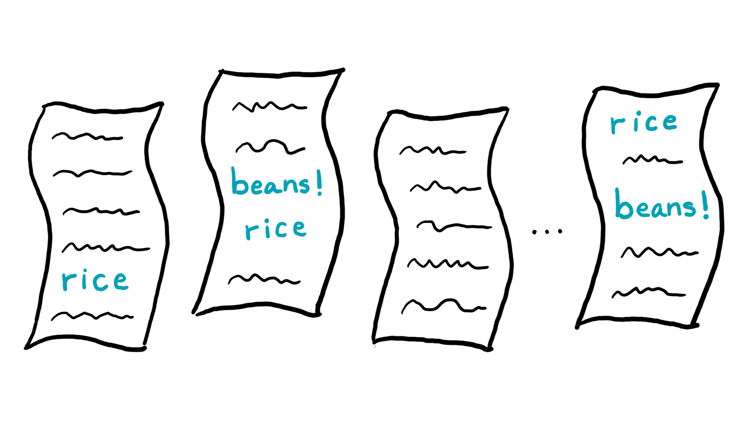

Slide 11
